Slide 1




Slide 2
Countdown timer python project
A simple python application

Slide 3


PRESENTED BY :
V.ARAVINDH
Y.BHARGAV
P.SIVAJI

Slide 4
CONTENTS
Introduction
Tools and technologies
Features
Working Examples
Python code over view
Demo

Slide 5
INTRODUCTION
What is count down timer ?
A countdown timer is a tool that counts down from a specific time to zero
Commonly used in events, exams , sports , propertivity tasks.
Purpose of project ?
To create a functional countdown timer using python.
Learn and apply basic python programming concept

Slide 6
Tools And Technologies
Programming Language :
Python Library Used:
Time : For handling time-related functions.
Tkinter : For creating a GUI

Slide 7
Features :
Simple User Interface (optional)
A basic interface using Tkinter (optional).
Customizable Time InputUsers can set the timer for any duration.
Visual and Audible AlertsNotifies the user when time is up

Slide 8
Working Example :
Example of Execution :
Users enter time in seconds.
The countdown starts, and updates the timer on the console.

Slide 9
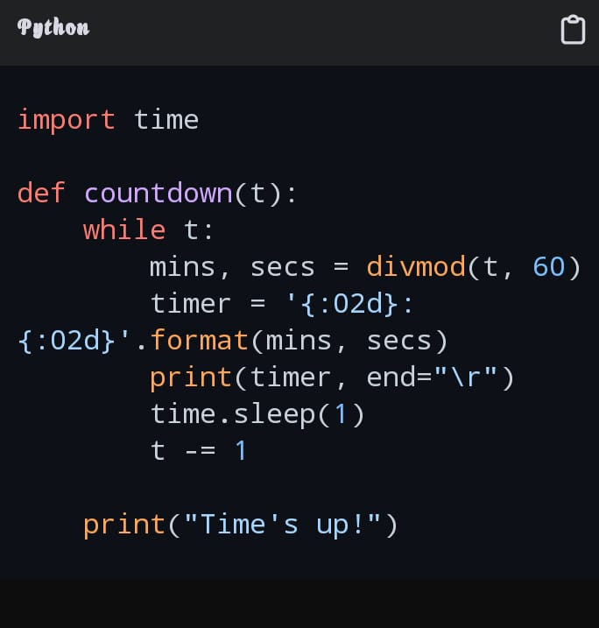
Python code over view :

Slide 10

THANK YOU

